Slide 1
Power Apps Extensions for Power BI/Fabric
Jon Stjernegaard Vöge

Slide 2
Jon Stjernegaard vöge
professional
Senior Consultant at Inspari – a valantic company, driving Power Platform & Fabric projects and community engagement
Education
MSc. Business Administration & E-Business from Copenhagen Business School, Denmark
Passion
Empowering business users to work better with data, making better decisions, and take matter into their own hands.
personal
28 years old, hobby cyclist, puzzle and board game nerd

Slide 3
agenda
FINAL SOLUTION DEMO
Why even bother with Power Apps embedded in Power BI/Fabric?
COMMENT EXTENSION
How to build a Sharepoint/Dataverse-based comment extension with Power Apps
FABRIC WRITE-BACK EXTENSION
How to build a Power App and Power Automate flow for LIVE data write-back to Fabric Warehouses
CHAT GPT EXTENSION
How to build a Chat-GPT interface embedded directly in Power BI/Fabric with Power Apps

Slide 4
Extension 1: Comment on data points
Why
Commenting on financial results, trends or other metrics may provide valuable insight. Power BI’s built in commenting is lackluster.
What
A Power App which understands the filter context from Power BI, can write comments to Dataverse/Sharepoint, to be brought back into the Power BI data model.
How
Demo time.

Slide 5
Extension 2: Write-Back to fabric
Why
End users often input data through Excel, resulting in poor data quality, and slow time-to-analysis.
What
A Power App allows for governed data entry/editing directly in a data warehouse. Embedding in Power BI allows for better context during entry.
How
Demo time.

Slide 6
Extension 3: CHAT GPT Extension for Power BI
Why
End Users may improve their understanding of data and insight by being able to look up relevant definitions and information directly in their reports.
What
A Power App which calls the Chat GPT API can mirror the chat experience known from the browser.
How
Demo time.

Slide 7
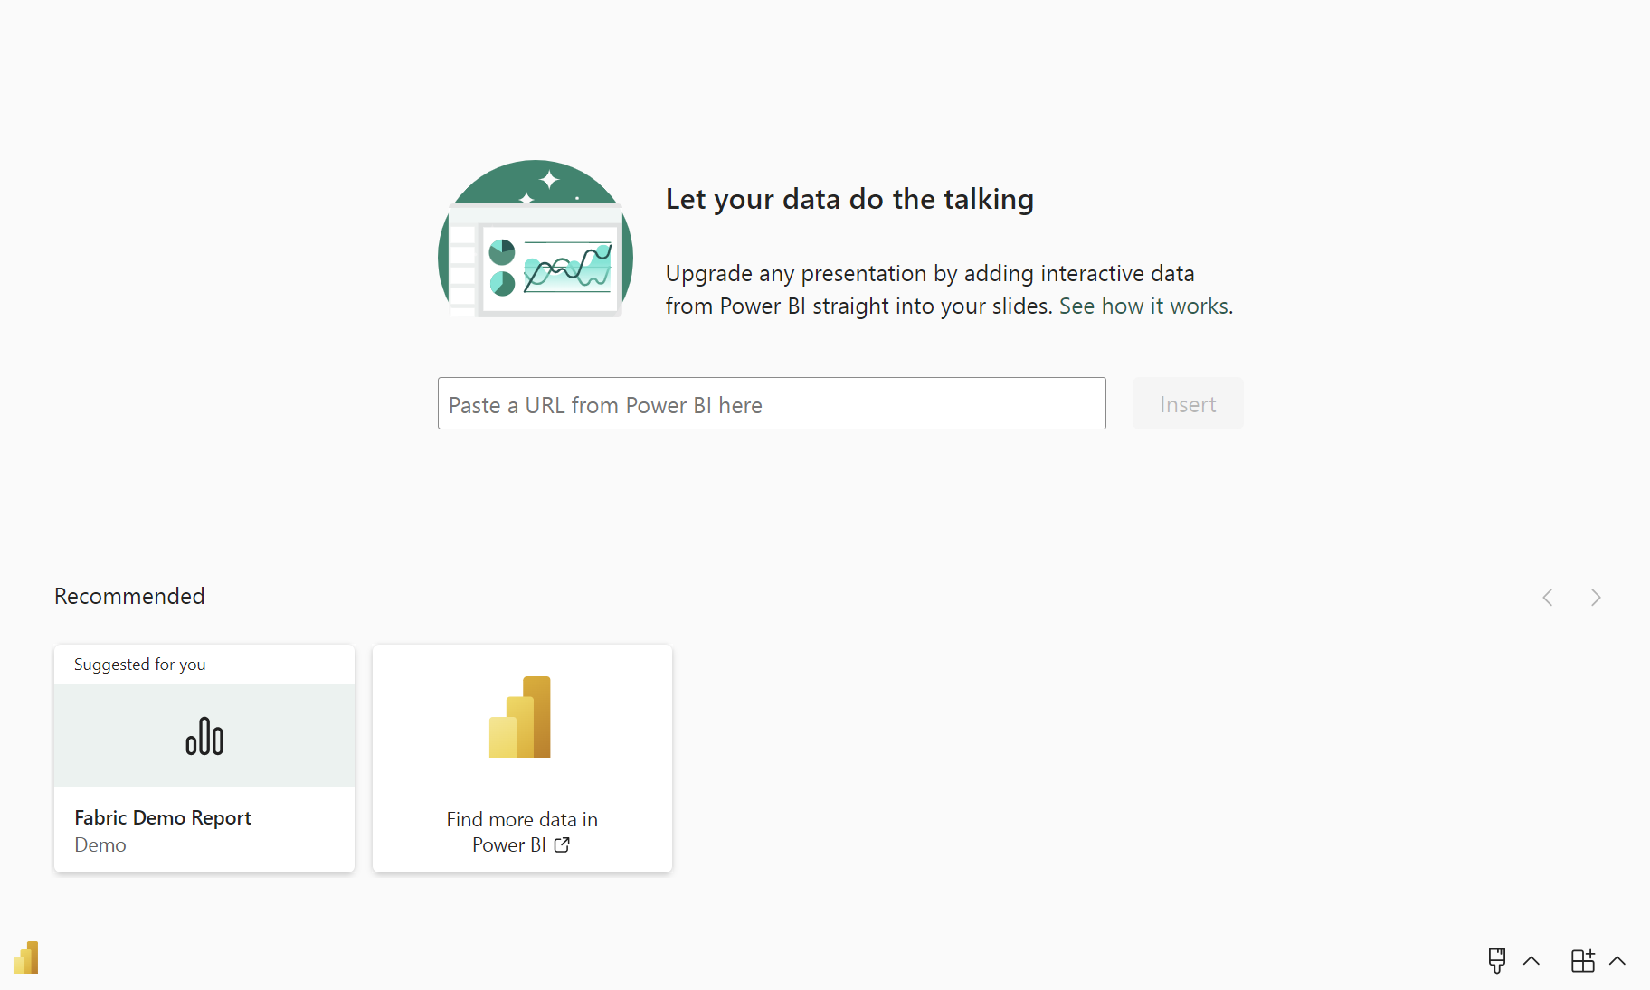

Slide 8
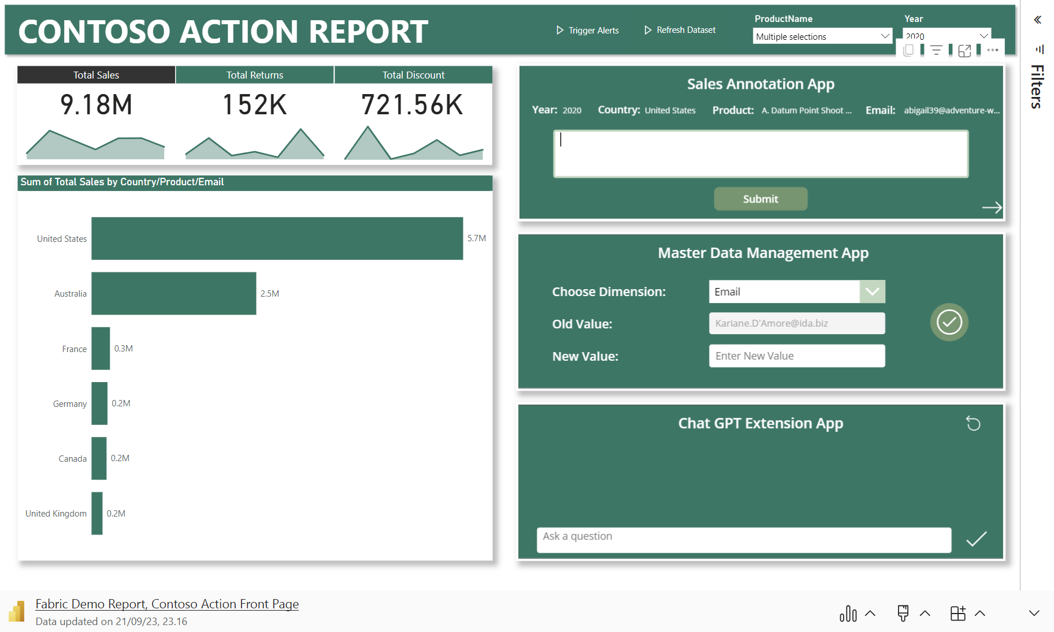

Slide 9
Additional Resources:
Articles:
Write-back to Fabric: https://www.linkedin.com/pulse/live-data-write-back-microsoft-fabric-warehouse-from-jon
Sync Dataverse to Fabric: https://www.linkedin.com/pulse/microsoft-fabric-power-platform-how-get-your-data-jon
Fabric Data Ingestion & Transformation for analysts: https://www.linkedin.com/pulse/fabric-analysts-part-1-data-ingestion-preparation-stjernegaard-v%25C3%25B6ge-fqu1e
Fabric Data Storage for analysts: https://www.linkedin.com/pulse/tutorial-fabric-analysts-data-storage-serving-jon-stjernegaard-v%25C3%25B6ge-sdgoe
Fabric Data Reporting for analysts: https://www.linkedin.com/pulse/tutorial-fabric-analysts-consuming-reporting-jon-stjernegaard-v%25C3%25B6ge-7lgwe
Fabric Data Activator for analysts: https://www.linkedin.com/pulse/tutorial-fabric-analysts-acting-data-activator-stjernegaard-v%25C3%25B6ge-a6dfe

Slide 10
Questions? feel Free to connect with me. LinkedIn: https://www.linkedin.com/in/jonvoge/ Sessionize: https://sessionize.com/jon-voge Download presentation material from github: https://github.com/Jonvoge/speaker-material

